Slide 1
1.Introduction to Internet
ICT-Training Technical Skills

Slide 2
History of Internet
The Internet was developed by Bob Kahn and Vint Cerf in the 1970s. They began the design of what we today know as the 'internet. ‘
It was the result of another research experiment which was called ARPANET, which stands for Advanced Research Projects Agency Network.

Slide 3
Internet
The Internet is the global (world wide) system of interconnected computer networks that uses the Internet protocol suit (TCP/IP) to communicate with one another or communicate between networks and devices.
World wide system of computer networks.

Slide 4
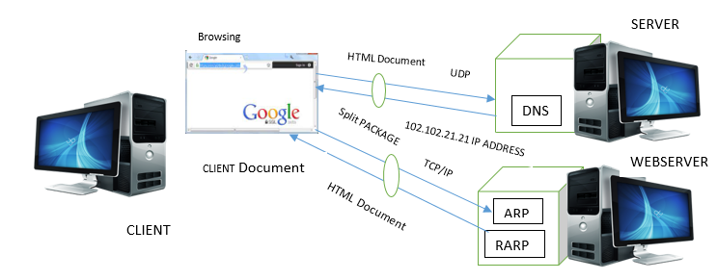
Diagram of Working Principle

Slide 5
Description
Client –any computer hardware or software device that requests access to a service provided by a server.
Client Document – Client working area - display document.
www.google.com – Fully Qualified Name/Domain Name/Url.
Google – Search Engine. Speed and Advanced cached technologies used
HTML Document – Send and Receive.
UDP – User Datagram Protocol.
TCP – Transmission Control Protocol.
IP – Internet Protocol.
DNS – Domain Name System.
ARP – Address Resolution Protocol.
RARP – Reverse Address Resolution Protocol.

Slide 6
Internet Working Principle
Client request type the url (www.google.com) name (i.e., HTML document) in a browser, that transfer a UDP protocol to search details from a DNS which act as a server.
The server provides a IP address (i.e., number sequence-102.102.21.21) that given to the browser.
At a few second of time, the browser got the IP address given to a TCP/IP protocol that use split packages then transfer to an ARP/RARP protocol which act as a web server.
The ARP arranges the orders of sequence packages number identified that provides the client need response to the HTML document.
Some time, if web server send response not correct to the client request, and retransmit on the data that uses the RARP protocol.
Finally, client gets the display screen (i.e., mobile, laptop or desktop, etc.) document (HTML document).

Slide 7
Overview of TCP/IP and UDP Protocol
TCP/IP | UDP
Transmission Control Protocol. | User Datagram Protocol
TCP is a connection oriented reliable protocol. | UDP is a connection less, non-reliable protocol.
Retransmission of packets. | No retransmission.

Slide 8
Overview of ARP and RARP
ARP | RARP
Address Resolution Protocol | Reverse Address Resolution Protocol
Mapping from logic address to physical address protocol. | Mapping from physical address to logic address protocol.

Slide 9
IP protocol
Internet Protocol Suit representing the address of each machine in a doted decimal format is known as Internet Protocol.
Eg: 102.102.21.21, 192.164.0.1
Computer or Mobile includes two address:
Therefore,
MAC Address – Physical Address (i.e., Manufacturing company)- E.g: Person Name
IP Address – Logic Address (i.e., unique)- E.g: Home Address.

Slide 10
Definitions
Client: Used in home and corporate networks, a client is any computer hardware or software device that requests access to a service provided by a server.
WWW: It is collection of machines particularly webservers (i.e., Web Engine) which provide HTML document.
Server – It is a computer program or device that provides a service to another computer program and its user, also known as the client.
Web Server – It is a computer that stores web server software and a website's component files (for example, HTML documents, images, CSS stylesheets, and JavaScript files).

Slide 11
DNS
This is a domain name system or service in which internet service translates the domain name into IP addresses because these are alphabetic and easy to remember.
Every time when we use a domain name, a DNS service must translate the name into the corresponding IP addresses.
Generic Domain:
This is also known as the organization domain which divides registered hosts as per the generic behaviour.
Named host:
.com : Commercial organization
.edu: Educational institution
.gov: Government Institutions
.mil : Military group
.net: Network Provider
.org: Organization – (low amount domain)
.in: Indian Organization

Slide 12
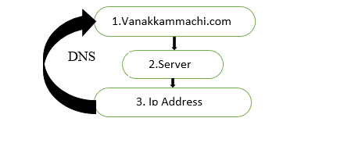
Create website
Domain name purchase
Server place order purchase
Server -> Ip Address -> DNS

Slide 13
Overview of HTTP
Hyper Text Transfer Protocol
HTTP is a protocol for fetching resources such as HTML documents.
It is the request (client), response (server) communication Model.
Request – Client
Response – Server
Document – HTML
Through – Browser
Hypertext:
It is a navigation link to one page to another page.

Slide 14
Continue ..
IMEI Number: International Mobile Equipment Identity
IMEI is a 15-17-digit code that is given to every mobile phone. This number is used by service providers to uniquely identify valid devices.
ARP: Address Resolution Protocol
Mapping from logic address to physical address protocol is called ARP.
RARP: Reverse Address Resolution Protocol
Mapping from physical address to logic address protocol is called RARP.
Webpage
It is an electronic document. It is a HTML document or HTML page.
Website
It is a collection of web pages.

Slide 15
Data base
Front End:
It is a presentation layer, which is create a using HTML, React and Angular.
Back End:
It is a data layer from which data is fetched and displayed in front end.
ADF – Azure Data Factory
Data bricks
Azure Data Factory is a cloud-based data integration service that allows you to create data-driven workflows in the cloud for orchestrating and automating data movement and data transformation.

Slide 16
Common back end data bases are,
MySQL database
Post SQL
SQL server
Oracle
Mongodb
ClickHouse

Slide 17
Database divided into two types,
Relational database (i.e., Structural database) - Table, row, column – (20% data store) E.g: C program
Non-relational database (i.e. Unstructural database) -No SQL-No table, row, column – (80% data store). E.g: C++, Java.

Slide 18
ADF
Azure Data Factory
Data bricks
Azure Data Factory is a cloud-based data integration service that allows you to create data-driven workflows in the cloud for orchestrating and automating data movement and data transformation.

